Slide 1














Slide 2
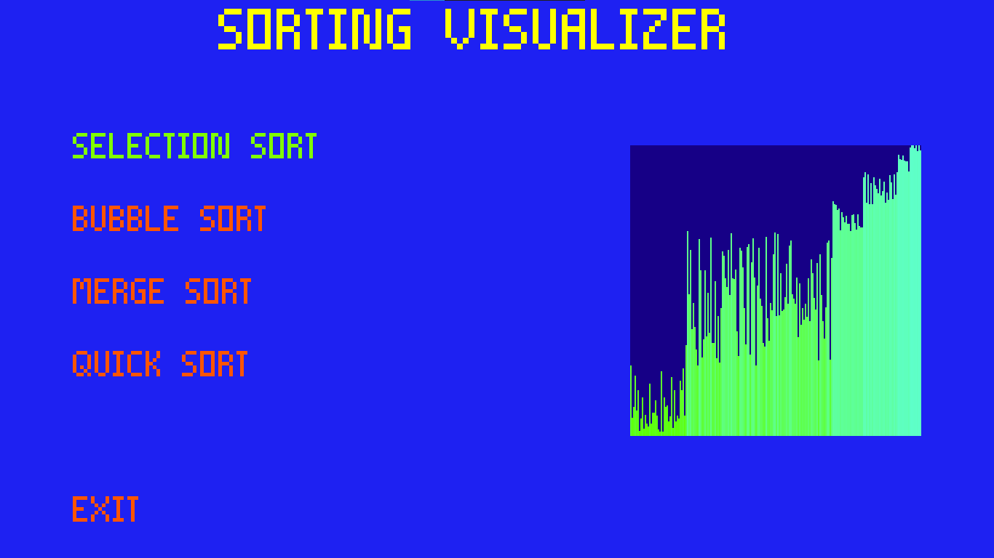
Starting screen
The options are selected using enter button
And to move use the arrow keys(up, down)
This is an animation
Of Sorting

Slide 3
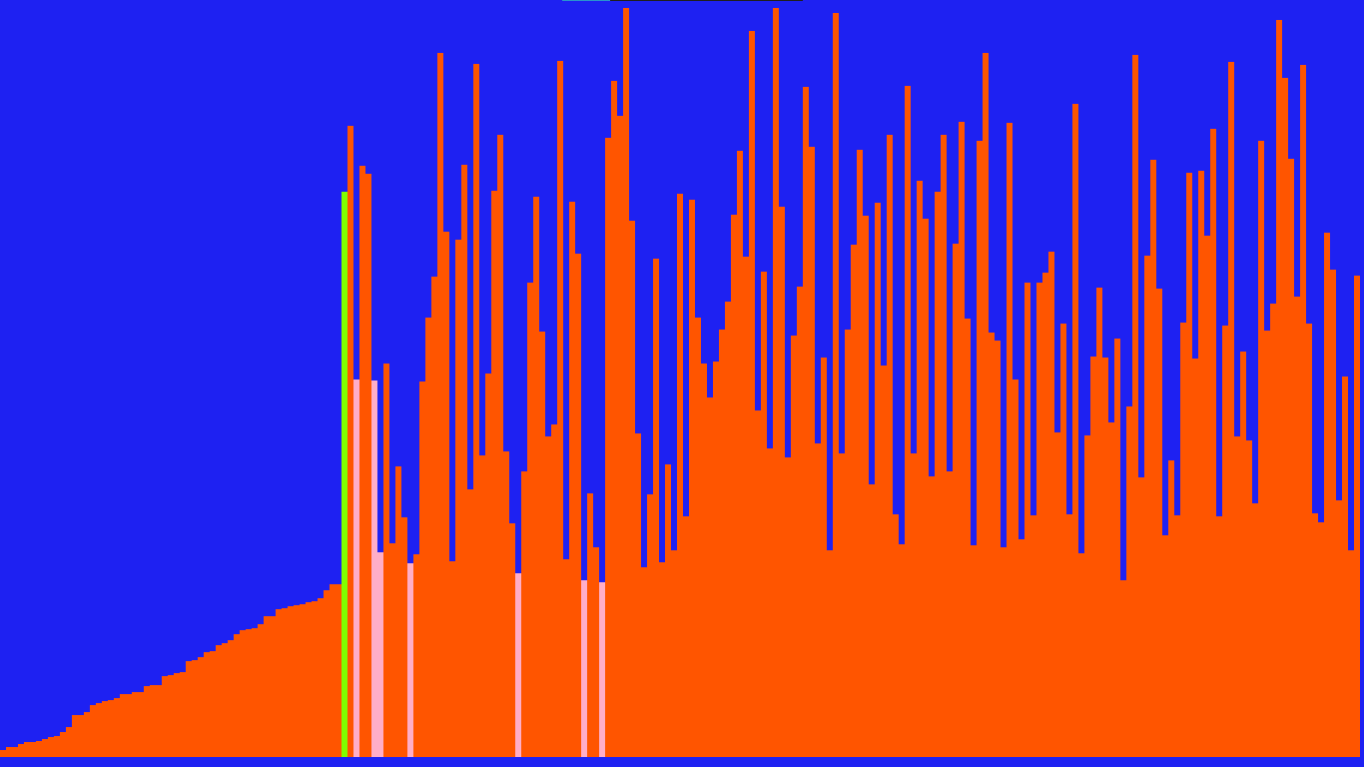
Selection sort
Current selected element
Minimum element founded is current iteration right most element is smallest among them

Slide 4
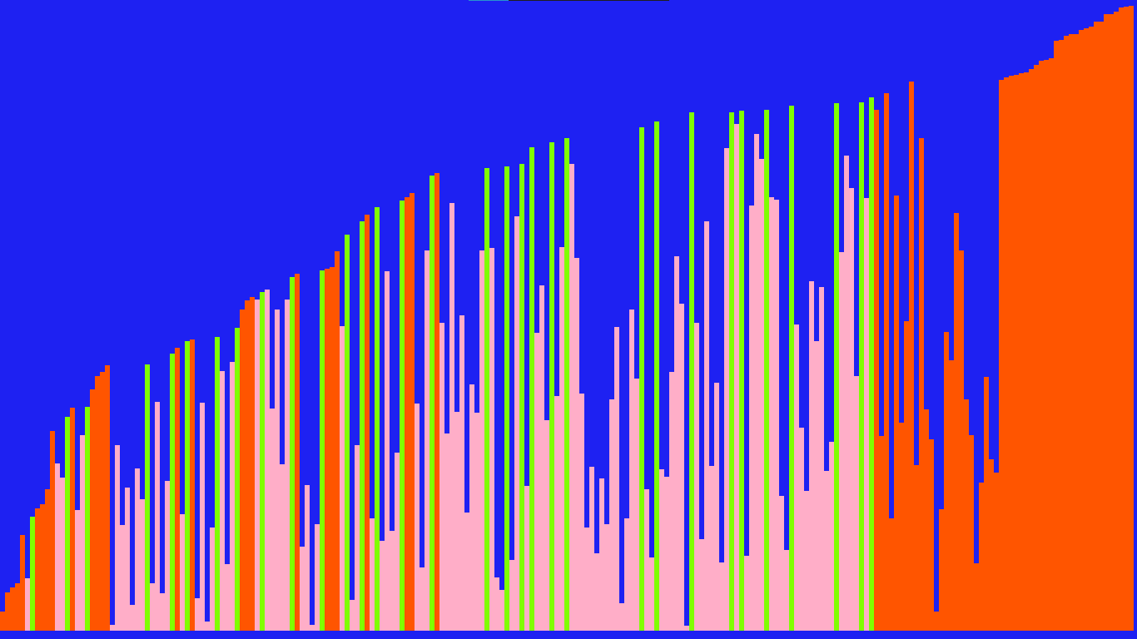
Bubble sort
In current iteration
Swapped once (right element is selected)
Swapped more than one time
Not swapped

Slide 5
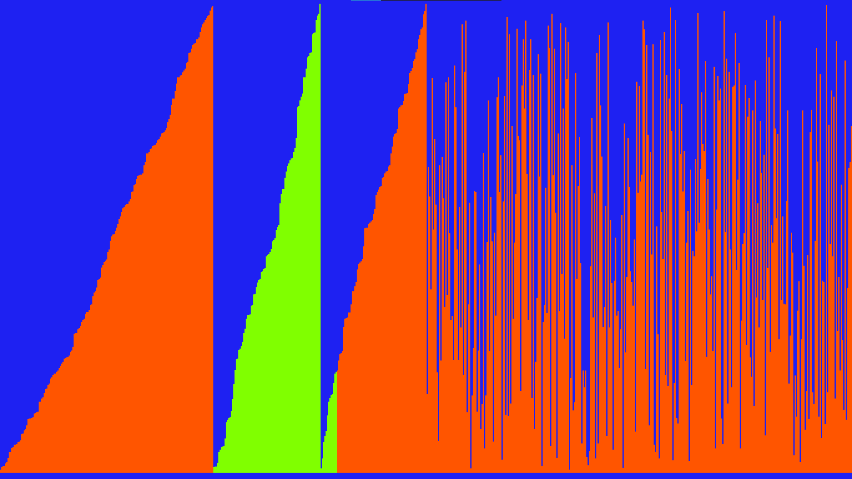
Merge sort
Elements are being sorted in small parts
(Left to Right)
Being copied
And merging again

Slide 6
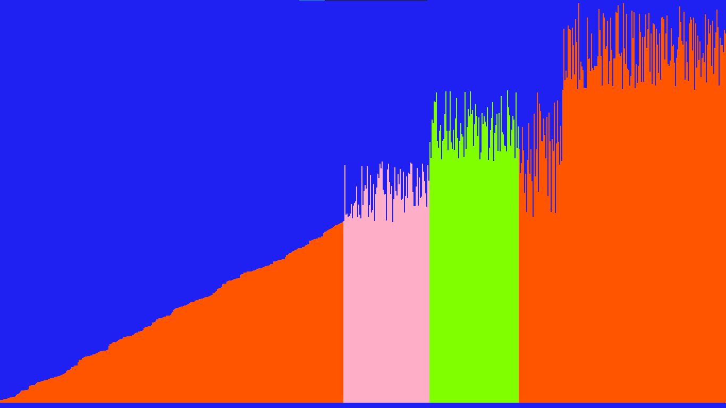
Quick sort
Unsorted elements are divided into two parts
Less than pivot
Grater than pivot
Parts gets smaller and elements get sorted

Slide 7
This application is made using
→C++14 and upper
→WIN32 APIs
(WinMain is the entry point of the application)
→Screen is a two dimensional array and each pixel has a 32 bit value/colour

Slide 8
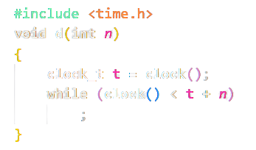
function used To replicate the time delay

Slide 9
We can observe the pattern of each sorting algorithm form the slower to one of the fasted. Thus we could visualise things and use them where they need.

Slide 10



